Slide 1
Database System

Slide 2
Database Architecture
Database Management Systems (DBMS) are often used by many users at the same time. To handle multiple users, different architectures have been developed.
Teleprocessing
File-server
Client-server

Slide 3
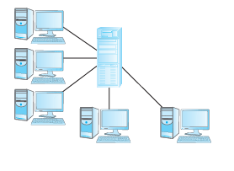
Teleprocessing
The earliest approach for multi-user systems.

Slide 4
How it works
One central computer with a single CPU.
Several user terminals (called “dumb terminals” because they cannot process anything themselves).
Terminals are connected (cabled) to the central computer.
User requests (input) go to the central computer → application program → DBMS → back to terminal.

Slide 5
Problem
The central computer must handle everything:
Running the DBMS
Running the application programs
Formatting and preparing output for each terminal
This creates a heavy load on the central machine and limits performance.

Slide 6
File-Server Architecture
A file-server is a computer on a network whose main purpose is to provide shared storage for files (documents, images, databases, etc.)
It acts like a shared hard disk for all users on the network.

Slide 7
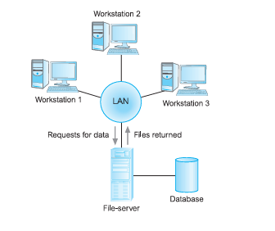

Slide 8
How It Works
Environment: Usually within a Local Area Network (LAN).
The file-server holds the files needed by applications and the DBMS.
However:
Applications and the DBMS run on each workstation (client PC).
When data is needed, the workstation requests the files from the server.

Slide 9
Example:
A user asks for names of staff working at branch 163 Main St
Problem: The file-server does not understand SQL.
So instead of sending only the correct staff names, it sends the entire Branch and Staff files to the workstation.
The workstation’s DBMS then filters out the result.
This creates huge unnecessary network traffic.

Slide 10
Main Disadvantages
High Network Traffic
Because large database files are transferred across the network (instead of just query results).
Full DBMS Required on Each Workstation
Every client must install and run its own DBMS software, which increases cost and complexity.

Slide 11
Concurrency, Recovery, and Integrity Issues
Multiple DBMS instances (one on each workstation) may try to update the same database files at the same time.
This makes synchronization and consistency control difficult
Recovery from failures is also more complicated

Slide 12
Client–Server Architecture
Why it was developed
The Teleprocessing and File-server architectures both had serious drawbacks:
Teleprocessing: Too much load on one central machine.
File-server: High network traffic, full DBMS copies on each client, and difficult concurrency control.

Slide 13
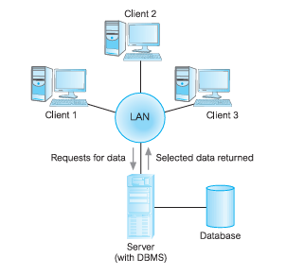
Client–Server Architecture

Slide 14
Client–Server Architecture
Client: The software (and computer) that requests some resource.
Server: The software (and computer) that provides that resource
Client and server can be on the same machine or on different machines in a network (most often in a LAN).
In databases, usually:
The client runs on the user’s desktop or workstation.
The server is a centralized machine running the DBMS.

Slide 15
Components of Data-intensive Applications
Applications in client–server DBMS systems are built from four components:
1. Database – The actual stored data.
2. Transaction logic – Manages transactions
Handles commit (permanent save) and rollback

Slide 16
3. Business & Data Application Logic
Business application logic : Organizational rules and policies.
Example. A student can register for a course only if prerequisites have been completed.
Ensures data reliability and consistency.
Data application logic : Database operations that enforce or support these rules.
4. User interface – The part that interacts with the end-user.

Slide 17
For example, the business rule says:
Only students who have passed Programming Fundamentals can register for Data Structures.
The data application logic might perform database operations such as:
It checks the database to see whether Ali passed.
If he passed: Allow registration
Otherwise. Reject

Slide 18
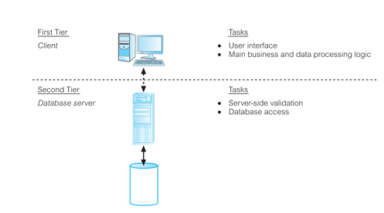
Traditional two-tier client server architecture

Slide 19
Two-tier Client–Server Architecture
Tier 1 (Client):
Mainly responsible for presentation services (UI).
May handle some basic application logic.
Tier 2 (Server):
Provides data services (query processing, transaction management).
Also handles:
  Authorization and access control
  Integrity constraints
  Concurrency control
  Recovery and backup
  Catalog management (metadata)

Slide 20
Example Workflow
1. User:
User enters a request (e.g., “Show all staff at branch 163 Main St.”).
2. Client:
Checks the request syntax.
Generates an SQL query.
Sends it to the server.

Slide 21
3. Server:
Verifies authorization and integrity constraints.
Executes the query (with transaction, concurrency, recovery support).
Returns only the result to the client.
4. Client:
Formats the result for the user (e.g., displays staff names).

Slide 22
Advantages of Client–Server Architecture
Wider access to databases – clients across the network can access the centralized server.
Better performance – tasks are split: client handles UI, server handles DBMS; both CPUs can work in parallel.
Lower hardware costs – only the server needs to be powerful; clients can be ordinary PCs.
Reduced communication costs – only results (not whole files) are sent over the network.
Increased consistency – integrity constraints are checked centrally at the server, not by each client separately.
Open systems support – works naturally with standard networked systems.

Slide 23
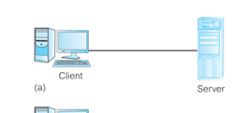
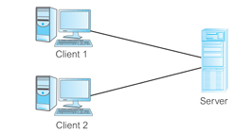
Client-server topologies

Slide 24
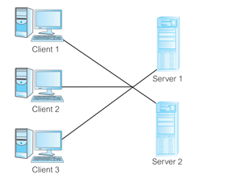
Client-server topologies

Slide 25
Three-Tier Client–Server Architecture
Introduced in the mid-1990s, the three-tier architecture added a middle tier to solve these problems:
1. User Interface Layer (Client Tier)
Runs on the end-user’s machine.
Responsible only for the presentation (UI) and maybe simple input checks.
Clients are now “thin clients” (lighter, cheaper, less powerful machines).

Slide 26
2. Business Logic & Data Processing Layer (Middle Tier / Application Server)
Runs on a separate server.
Contains the core business rules and logic (e.g., validating transactions, applying policies, processing workflows).
Handles multiple clients at once.
Acts as a “bridge” between the client and the database.

Slide 27
3.Data Layer (Database Server)
Runs the DBMS.
Responsible only for storing and retrieving data.
Interacts with the middle tier, not directly with clients.

Slide 28
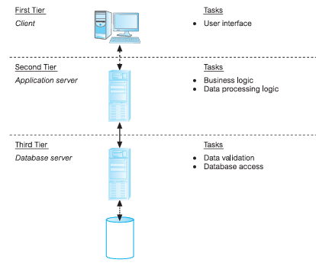
Three-Tier Client–Server Architecture

Slide 29
How It Works
The client (UI) sends a request to the application server.
The application server processes business rules, then generates database queries.
The database server (DBMS) executes the queries and sends results back to the application server.
The application server formats and applies further processing, then sends results back to the client.

Slide 30
Why It Was Needed
The two-tier model (client + DBMS server) worked fine for small to medium systems, but when applications expanded to hundreds or thousands of users, it faced problems:
Fat Client
Clients needed lots of resources (CPU, RAM, disk space) to run business logic locally.
This increased hardware costs.
Administration Overhead
  Each client needed its own copy of application software, making updates and maintenance difficult.

Slide 31
Advantages over Two-Tier
Thin clients → cheaper hardware requirements.
Centralized maintenance → business logic is only on the application server, not on every client.
Modularity → easy to replace or upgrade one tier without affecting others.
Load balancing → application servers can distribute requests before hitting the database.
Naturally fits into web systems:
Browser = thin client
Web server = application server
Database server = DBMS

Slide 32
Example
Banking System (Web App):
  Client: Customer uses a web browser to request account balance.
  Application Server: Applies business rules (check authentication, calculate interest, apply security rules).
  Database Server: Fetches the customer’s account data.

Slide 33
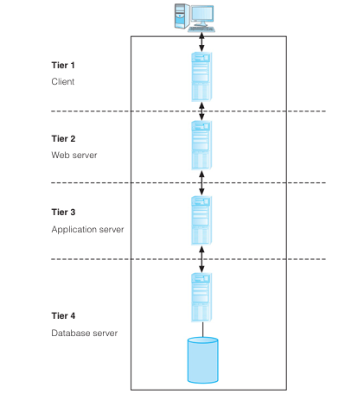
N-Tier Architectures

Slide 34
What It Means
N-tier architecture is simply an extension of the three-tier model.
Instead of just three layers (Client, Application, Database), the system can be broken into more layers (n layers) depending on the complexity and scalability needs.
Each tier runs on its own server or group of servers and is responsible for a specific function.

Slide 35
Example of Expanding Three-Tier
In three-tier:
  Client (UI)
  Application/Business logic
  Database
In n-tier (say 4-tier), you could split the middle tier:
  Web Server (Presentation Tier) → handles HTTP requests, static content.
  Application Server (Business Logic Tier) → processes business rules, transactions.
  Database Server (Data Tier) → stores and retrieves data.

Slide 36
Typical N-Tier Example in Web Systems
Client Tier → User’s browser or mobile app.
Web Server Tier → Handles HTTP requests, delivers web pages.
Application Server Tier → Executes business logic, enforces rules.
Database Server Tier → Stores relational or NoSQL data.

Slide 37
Three-Schema Architecture
The goal of the three-schema architecture is to separate user applications from the physical database. It provides three distinct levels of abstraction:
User applications refer to the programs, tools, or interfaces that people use to interact with the database in order to perform tasks.
Internal Level (Physical Storage Schema)
Conceptual Level (Community Schema)
External Level (User Views)

Slide 38
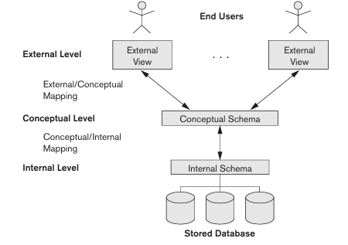
Three-Schema Architecture

Slide 39
Internal Level (Physical Storage Schema)
Describes how data is physically stored in the database.
Includes details such as storage structures (files, indexes, hashing), and access paths.
Uses a physical data model.

Slide 40
Example
The university database stores Exam Results in a table:
Result(RollNo, CourseCode, Marks)
Initially, data is stored on a local server at the university.
Later, the university upgrades:
Partitions data (1st-year results on one disk, 2nd-year results on another).
Impact on App (Result Portal).
Roll No: 21CS45
Course: DBMS
Marks: 87
The student does not know (or care) if data is on a hard disk, SSD, or cloud.
physical independence → the storage changed, but the app view remained the same.

Slide 41
2. Conceptual Level (Community Schema)
Describes the structure of the whole database as seen by the community of users.
Defines entities, data types, relationships, constraints, and user operations.
Hides details of the physical storage.

Slide 42
3. External Level (User Views)
Describes the part of the database that a specific user group is interested in.
Each user (or application) may have a different external schema.
Hides the rest of the database not relevant to that user.
Example: a student’s external view may show only Name and GPA, while the admin’s view shows Name, RollNo, GPA, FeeStatus.

Slide 43
Data Independence in the Three-Schema Architecture
Data Independence is the ability to change the schema at one level of a database system without affecting the schema at the next higher level.

Slide 44
Logical Data Independence
Definition: The ability to change the conceptual schema without requiring changes to external schemas or application programs.
Change structure without affecting user views.
Logical data independence ensures user applications (like portals, reports) still work even when new attributes are added.

Slide 45
Example
Suppose the university has a Student table:
Student(RollNo, Name, Address)
Roll No: 21CS45
Name: Ayesha Khan
Address: House #12, University Road, Karachi
Later, the administration decides to store more details by splitting Address into: Student(RollNo, Name, Street, City,postcode)
Impact on App (Student Portal)
The student portal (app) still shows a single “Address” field on the screen:

Slide 46
Physical Data Independence
Definition: The ability to change the internal schema (physical storage) without changing the conceptual schema (logical structure).
Applications and queries remain unchanged

Slide 47
Example
The university database stores Exam Results in a table:
Result(RollNo, CourseCode, Marks)
Initially, data is stored on a local server at the university.
Later, the university upgrades:
Partitions data (1st-year results on one disk, 2nd-year results on another).
Impact on App (Result Portal).
Roll No: 21CS45
Course: DBMS
Marks: 87
The student does not know (or care) if data is on a hard disk, SSD, or cloud.
physical independence → the storage changed, but the app view remained the same.

